Slide 1
Text Directions

Slide 2
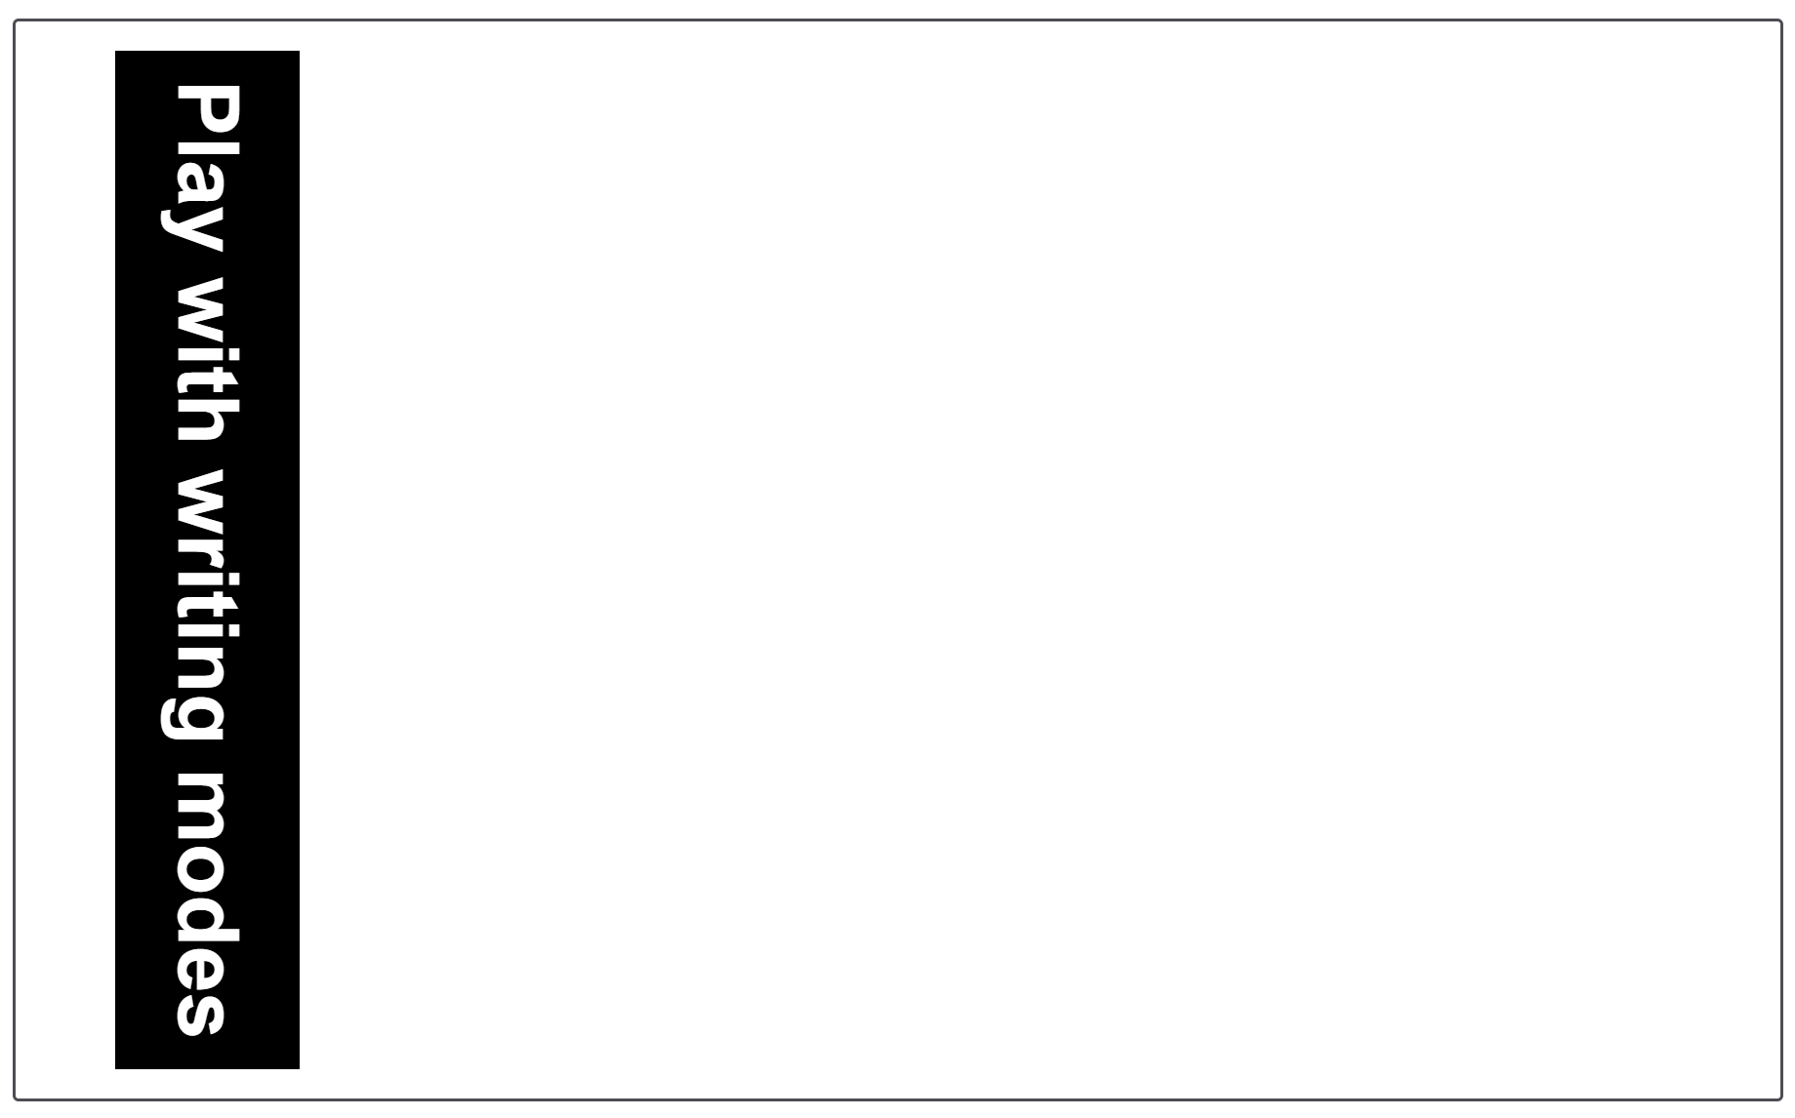
Writing mode
A writing mode in CSS refers to whether the text is running horizontally or vertically.
The writing-mode property lets us switch from one writing mode to another.
In the example below we have a heading displayed using writing-mode: vertical-rl.

Slide 3
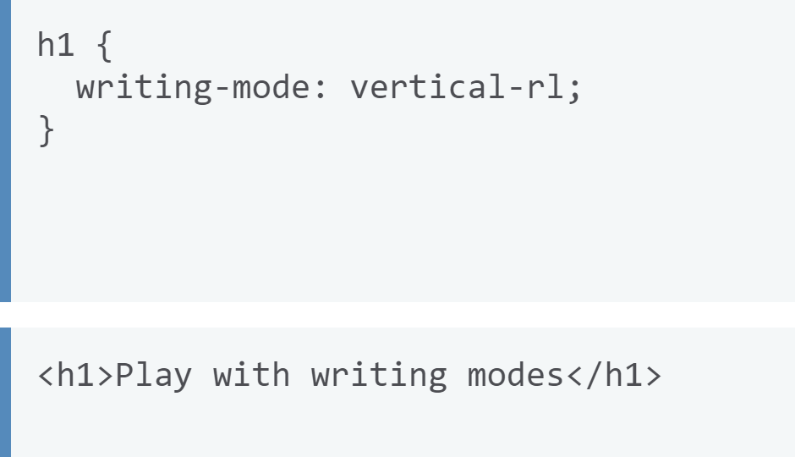
CSS

Slide 4
Writing mode
The three possible values for the writing-mode property are:
horizontal-tb: Top-to-bottom block flow direction. Sentences run horizontally.
vertical-rl: Right-to-left block flow direction. Sentences run vertically.
vertical-lr: Left-to-right block flow direction. Sentences run vertically.
So the writing-mode property is in reality setting the direction in which block-level elements are displayed on the page — either from top-to-bottom, right-to-left, or left-to-right.
This then dictates the direction text flows in sentences.
In the example below we have a heading displayed using writing-mode: vertical-rl.

Slide 5
Overflow
We already know that everything in CSS is a box, and that we can constrain the size of these boxes by giving them values of width and height (or inline-size and block-size).
Overflow is what happens when you have too much content in a box, so it won't fit inside it comfortably.
CSS gives you various tools to manage this overflow

Slide 6
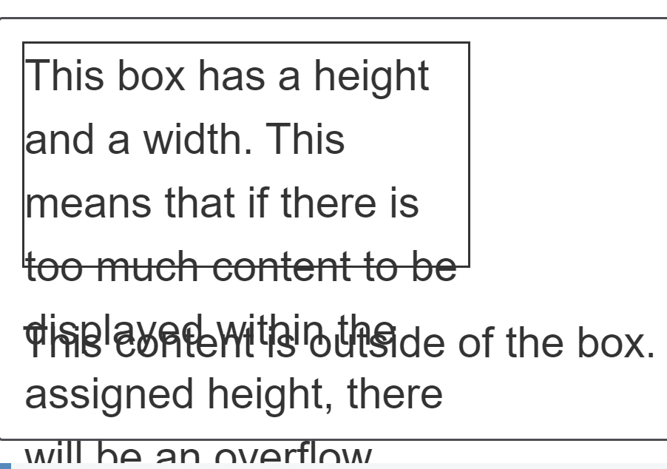
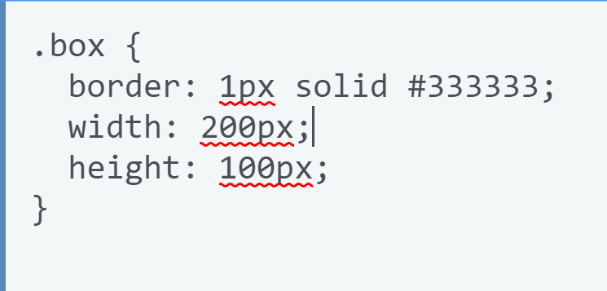
Overflow
In the example above, the box has been restricted by giving it a height and a width
We have then added more content than there is space for in this box.
The content is overflowing the box and laying itself rather messily over the paragraph below the box.
If you need a fixed size you can also control how the overflow behaves.

Slide 7
CSS tries to avoid “data loss”
Wherever possible CSS does not hide your content; to do so would cause data loss, which is usually a problem.
In CSS terms, this means some content vanishing.
The problem with content vanishing is that you might not notice it has vanished

Slide 8
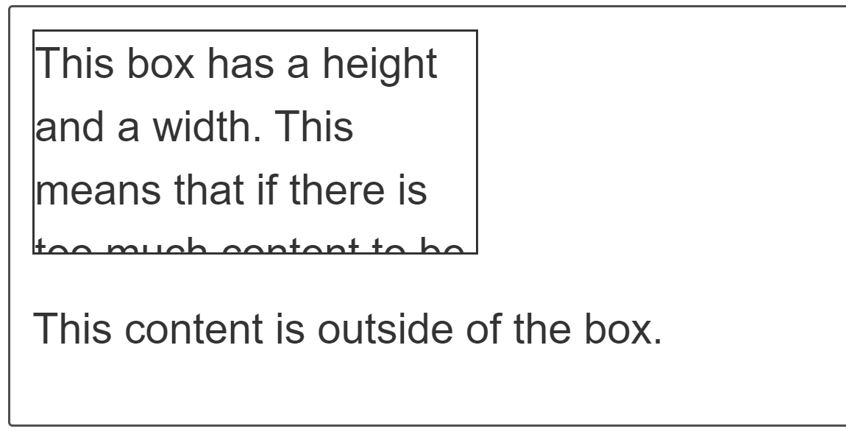
Overflow Property
The overflow property is how you take control of an element's overflow and tell the browser how you want it to behave.
The default value of overflow is visible, which is why by default we can see our content when it overflows.
If you want to crop the content when it overflows you can set overflow: hidden on your box.

Slide 9
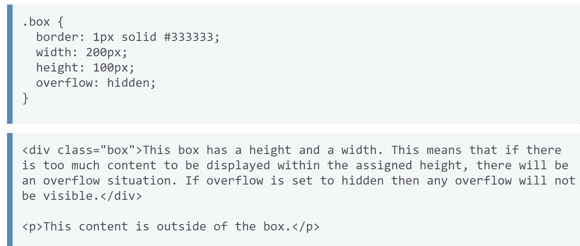
Overflow Property

Slide 10
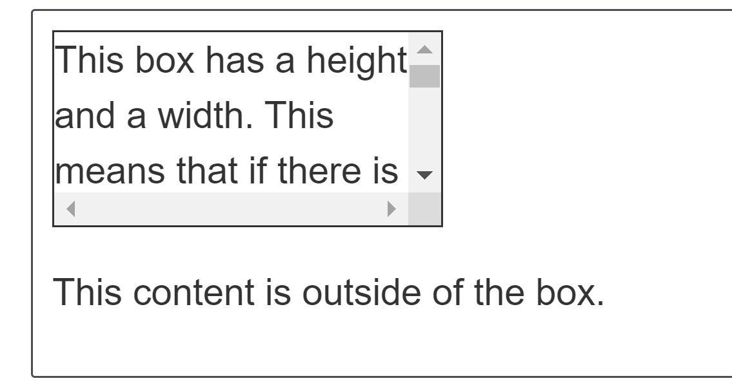
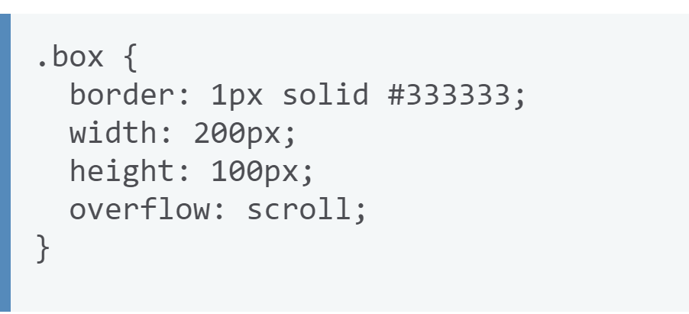
Overflow Property
Perhaps you would instead like to add scrollbars when content overflows?
If you use overflow: scroll then your browser will always display scrollbars — even if there is not enough content to overflow.

Slide 11
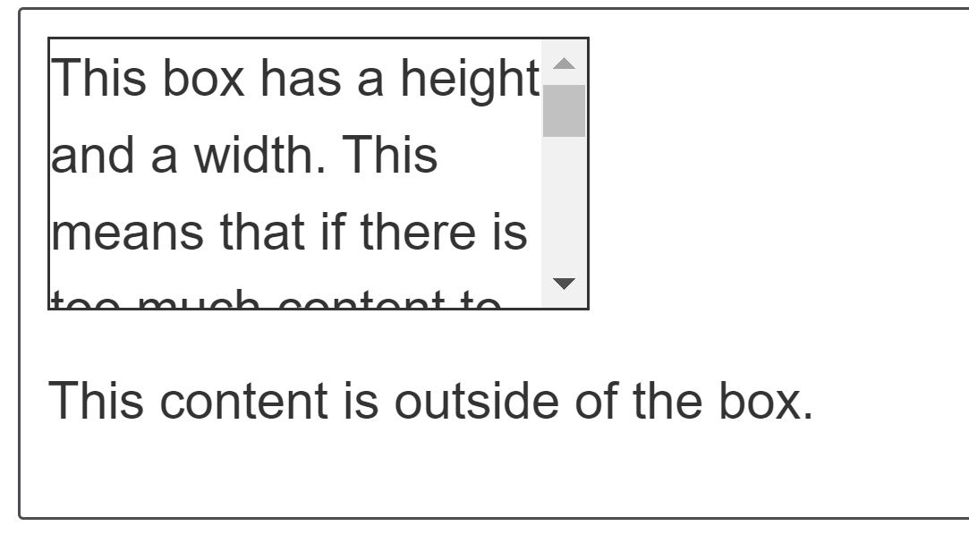
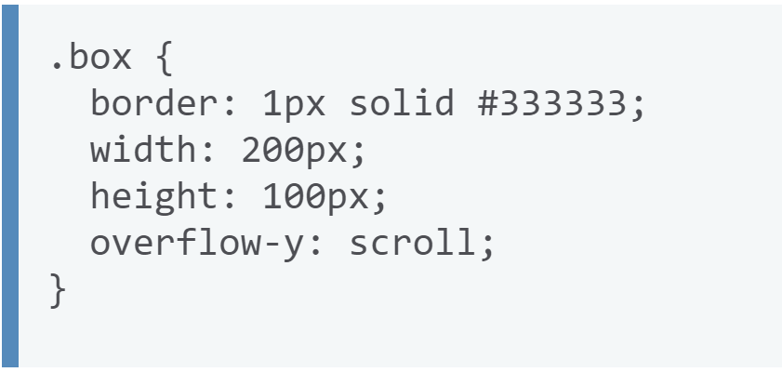
Overflow Property
In the above example we only need to scroll on the y axis, however we get scrollbars in both axes. You could instead use the overflow-y property, setting overflow-y: scroll to only scroll on the y axis.

Slide 12
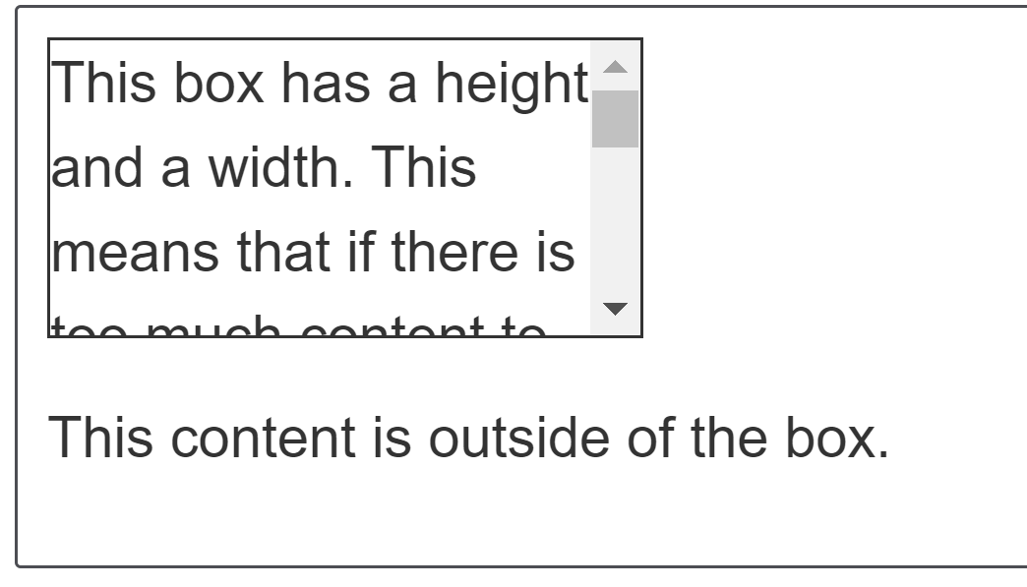
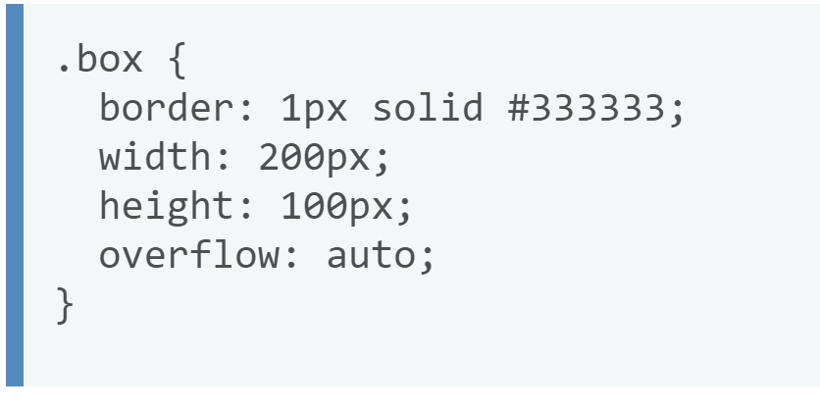
Overflow Property
If you only want scrollbars to appear if there is more content than can fit in the box, then use overflow: auto.

Slide 13
CSS values and Units

Slide 14
Lengths
The numeric type you will come across most frequently is <length>, for example 10px (pixels) or 30em.
There are two types of lengths used in CSS — relative and absolute.
It's important to know the difference in order to understand how big things will become.

Slide 15
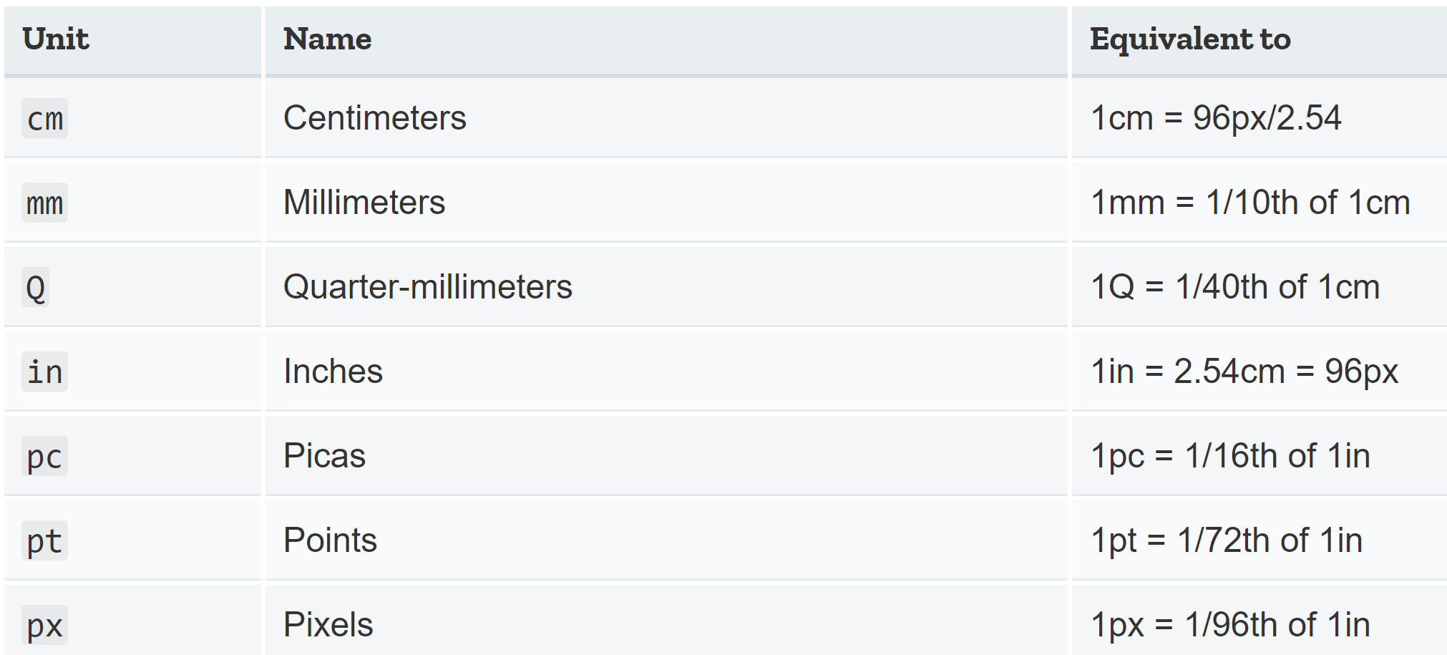
Lengths
Absolute Lengths
The following are all absolute length units — they are not relative to anything else and are generally considered to always be the same size.

Slide 16
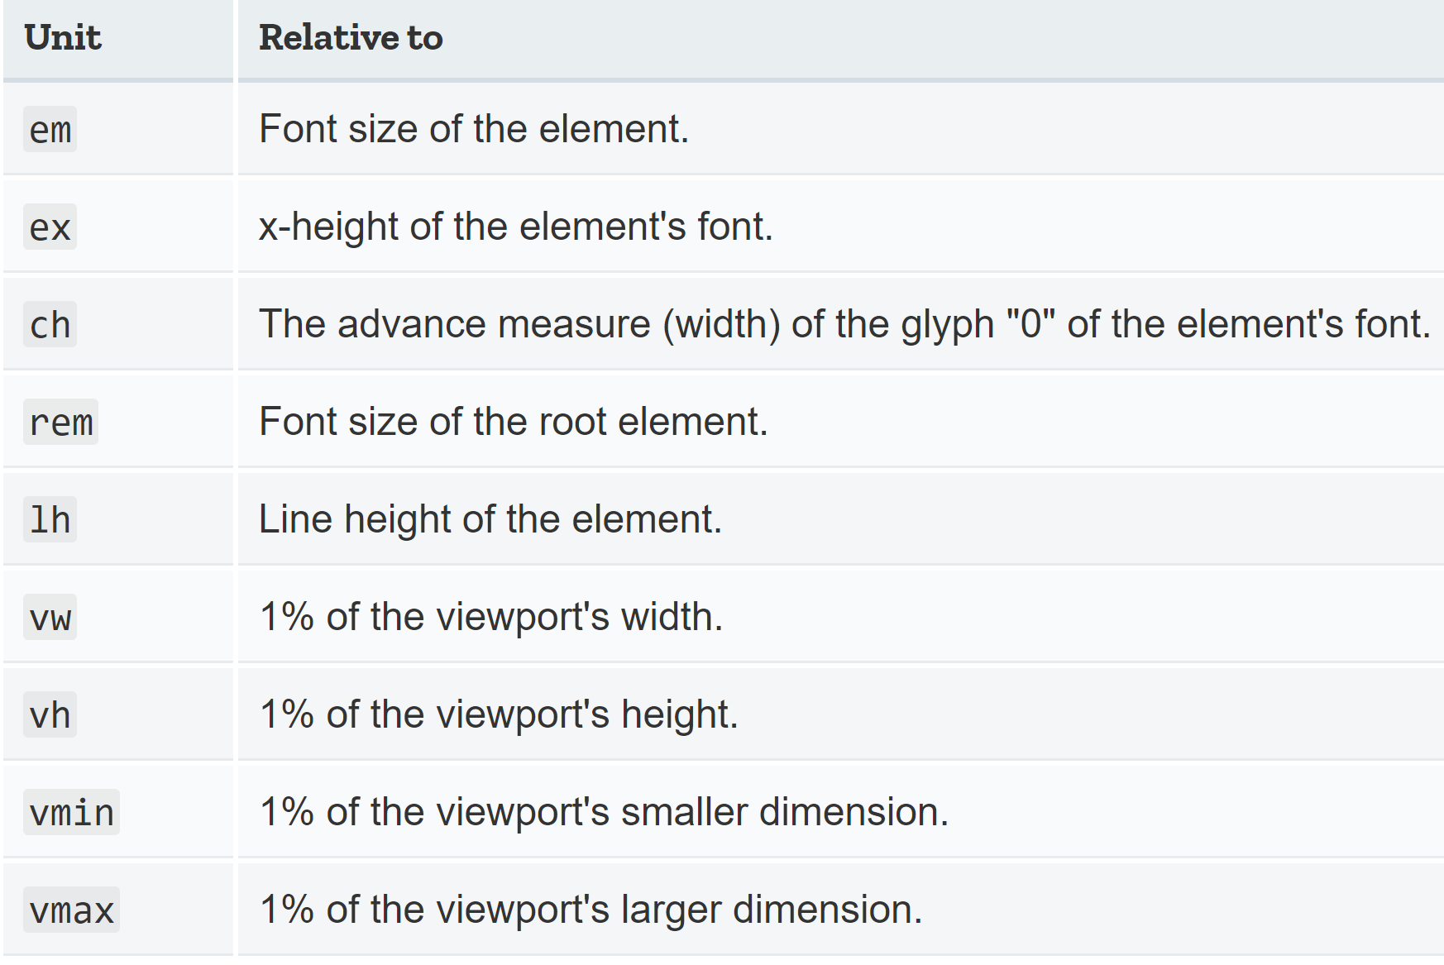
Lengths
Relative Lengths
Relative length units are relative to something else, perhaps the size of the parent element's font, or the size of the viewport.

Slide 17
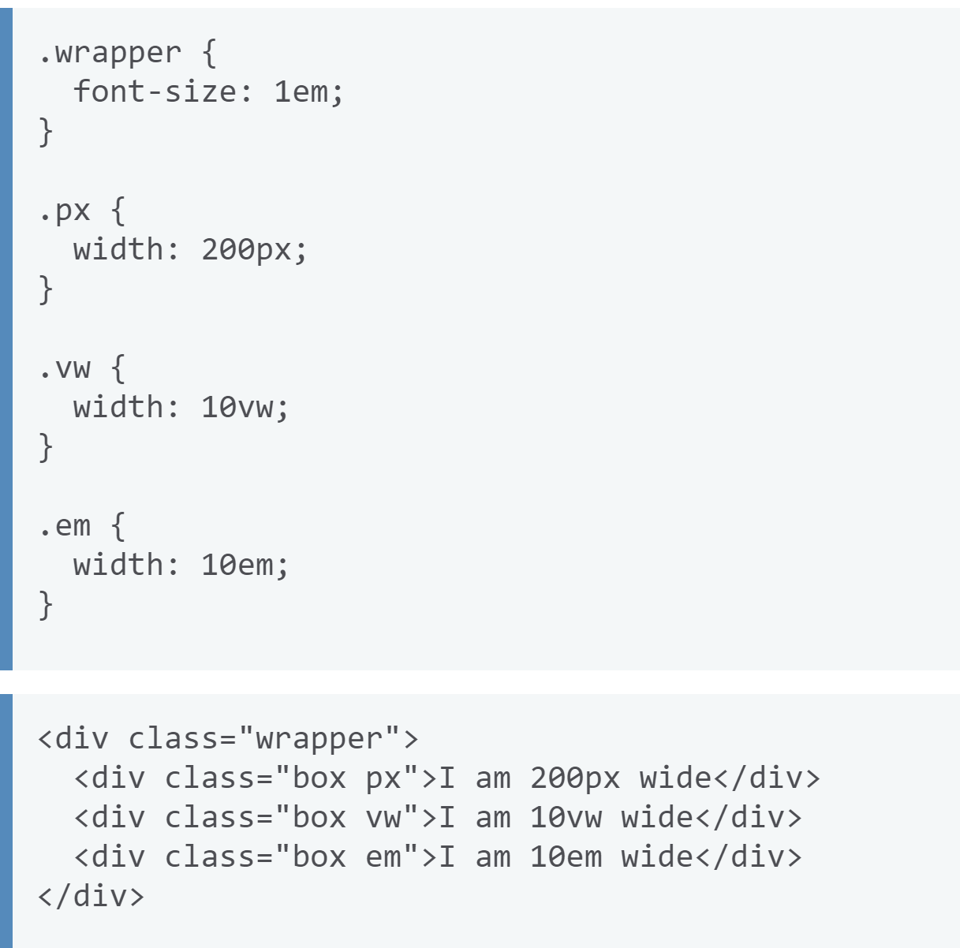
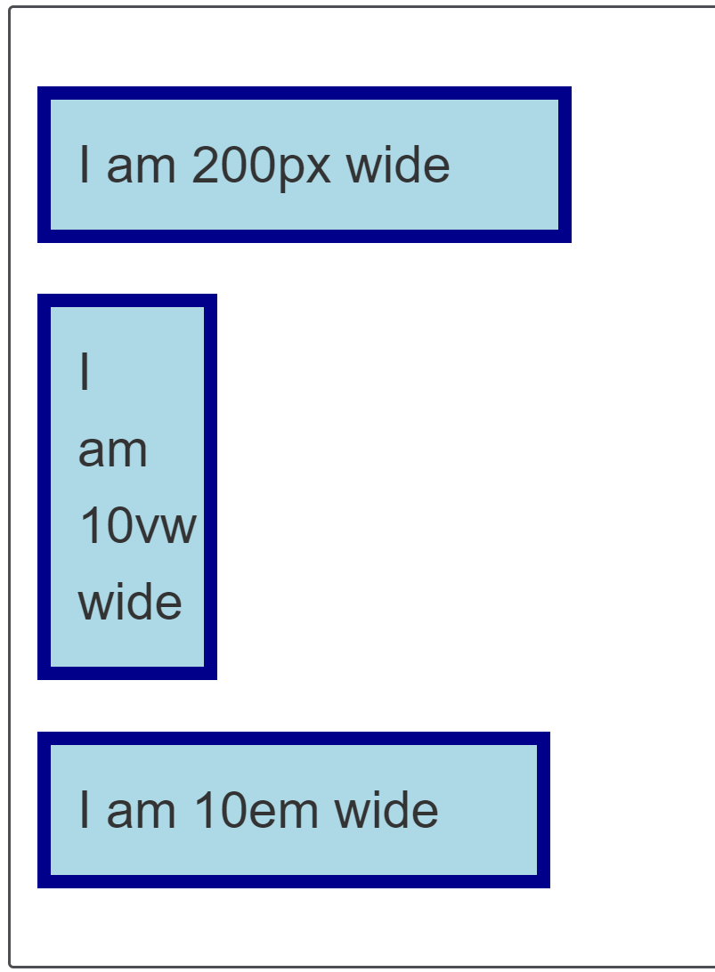
Lengths
Example:

Slide 18
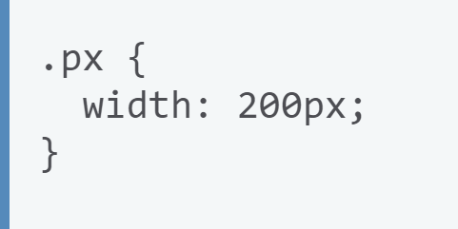
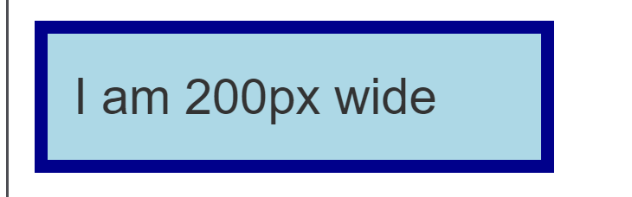
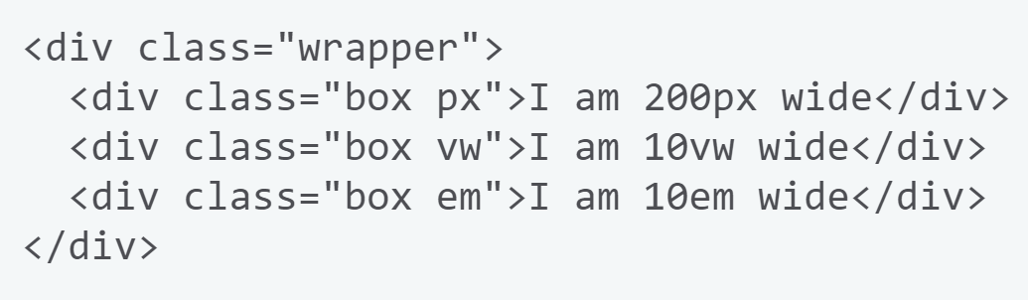
Lengths
In the example below you can see how some relative and absolute length units behave. The first box has a width set in pixels.
As an absolute unit this width will remain the same no matter what else changes.

Slide 19
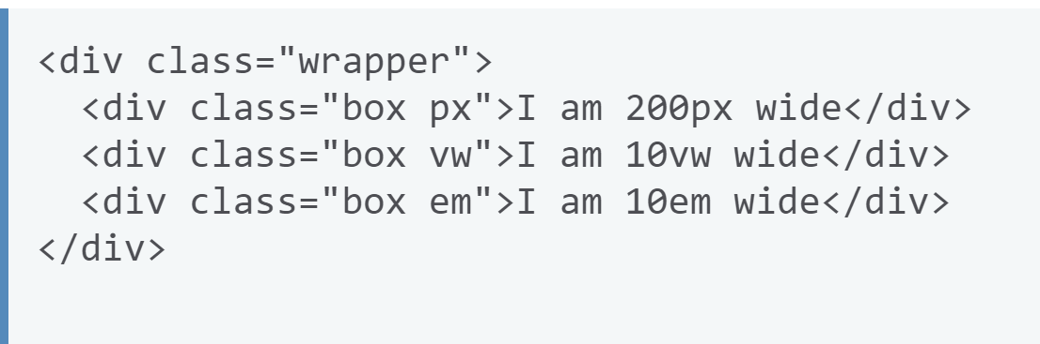
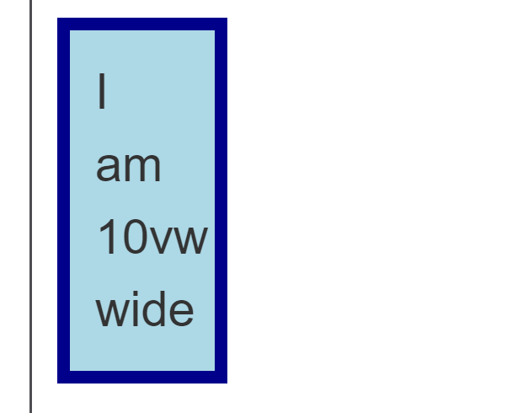
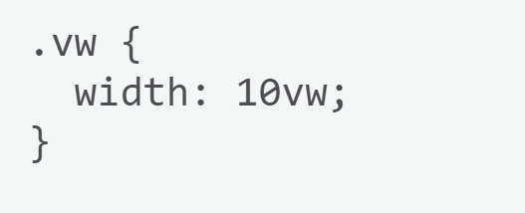
Lengths
The second box has a width set in vw (viewport width) units. This value is relative to the viewport width, and so 10vw is 10 percent of the width of the viewport. If you change the width of your browser window, the size of the box should change

Slide 20
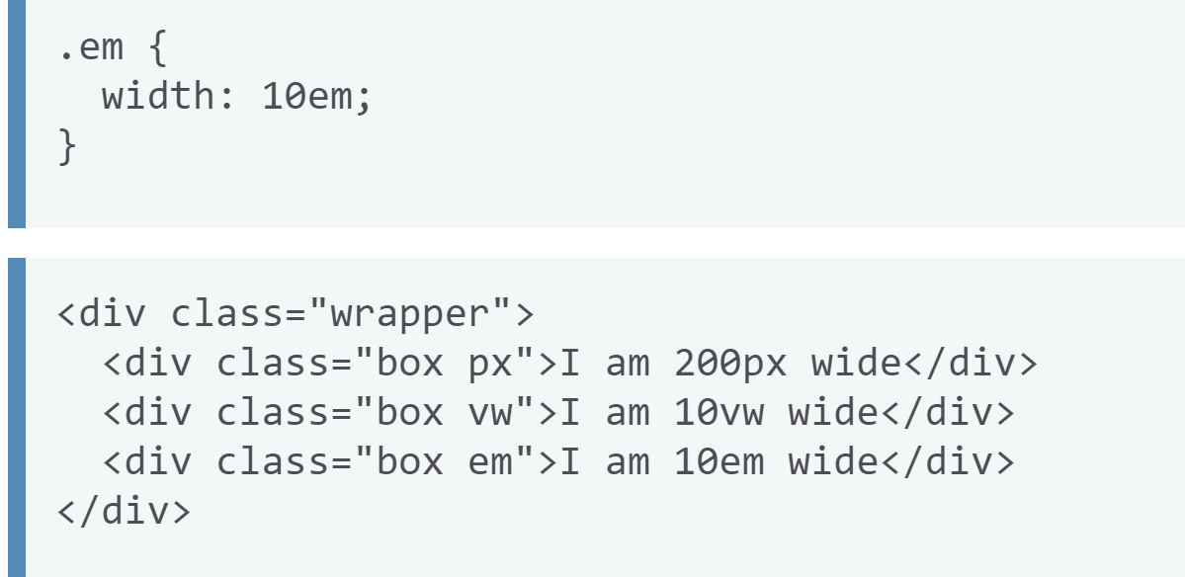
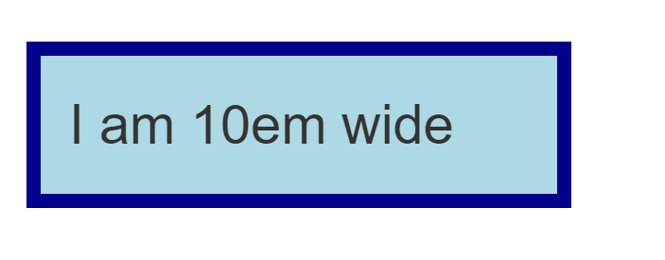
Lengths
The third box uses em units.
These are relative to the font size. I've set a font size of 1em on the containing <div>, which has a class of .wrapper.
Change this value to 1.5em and you will see that the font size of all the elements increases, but only the last item will get wider, as the width is relative to that font size.

Slide 21
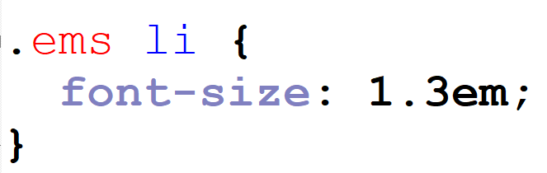
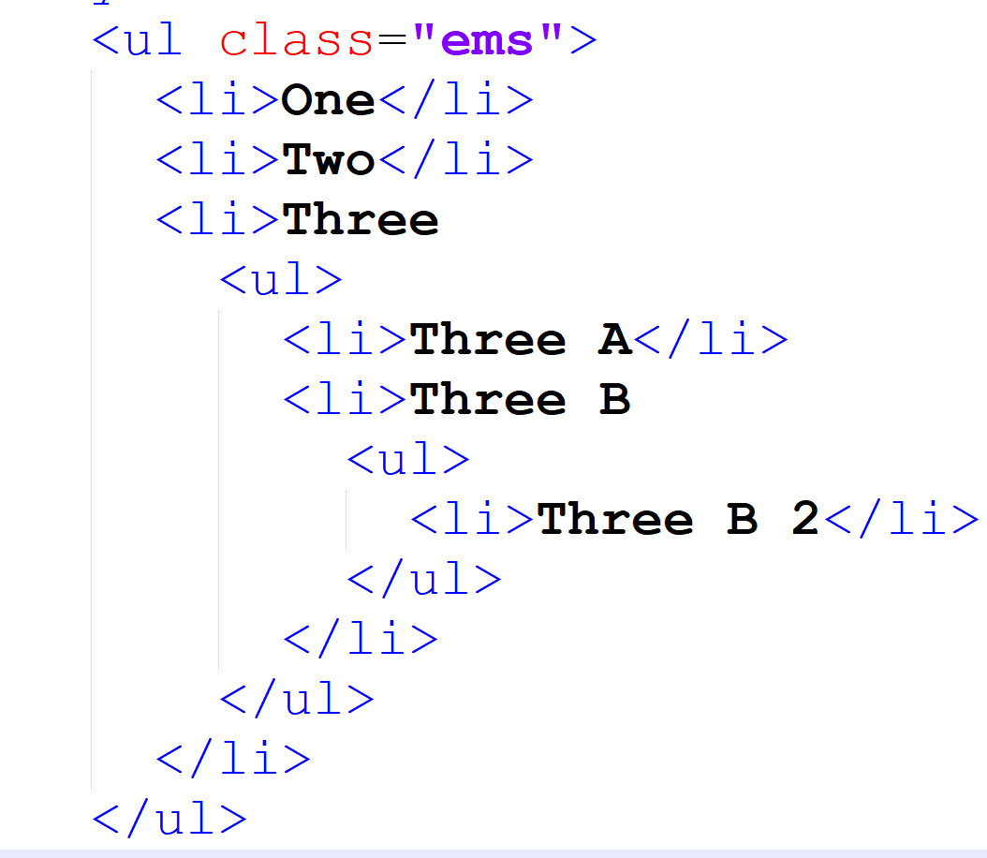
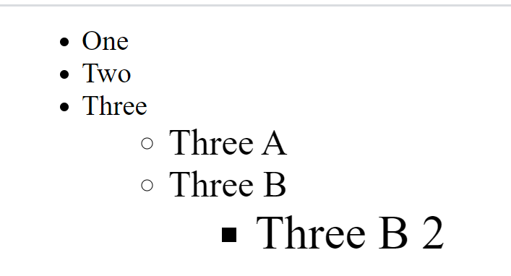
Lengths
em and rem are the two relative lengths you are likely to encounter most frequently when sizing anything from boxes to text.
The em unit means "my parent element's font-size". The <li> elements inside the <ul> with a class of ems take their sizing from their parent.
So each successive level of nesting gets progressively larger, as each has its font size set to 1.3em — 1.3 times its parent's font size.

Slide 22
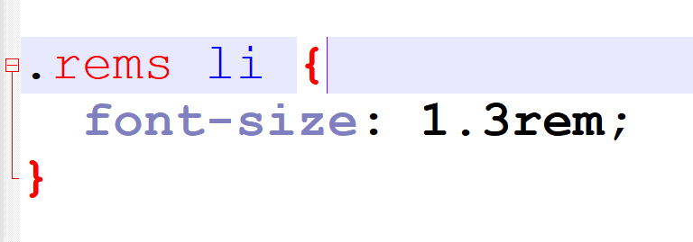
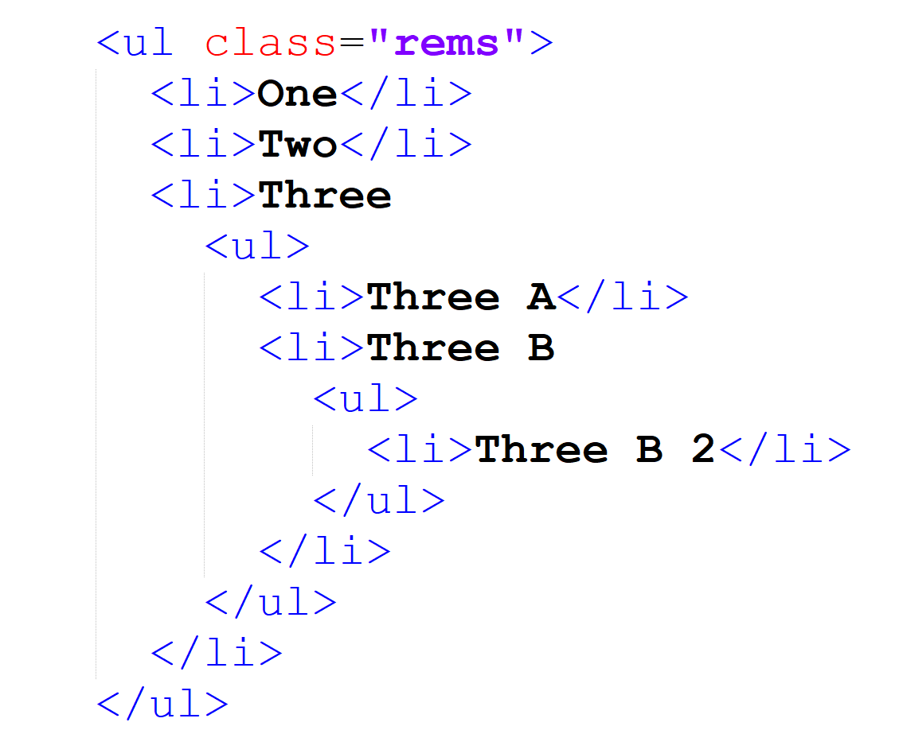
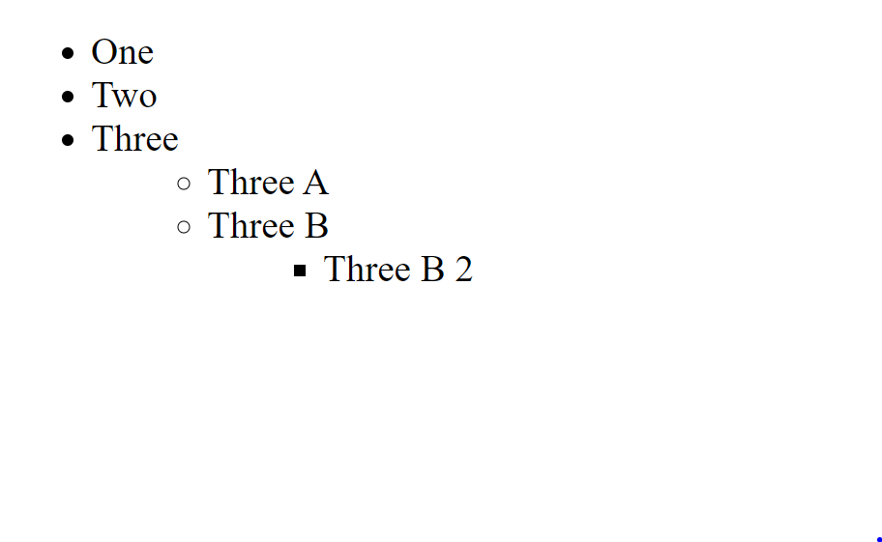
Lengths
The rem unit means "The root element's font-size". (rem standards for "root em".) The <li> elements inside the <ul> with a class of rems take their sizing from the root element (<html>).
This means that each successive level of nesting does not keep getting larger.

Slide 23
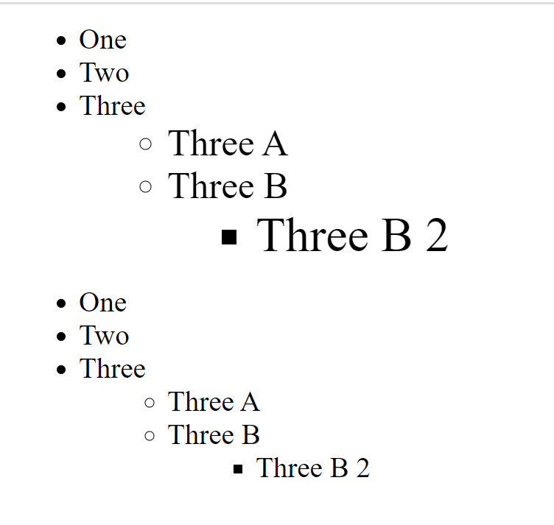
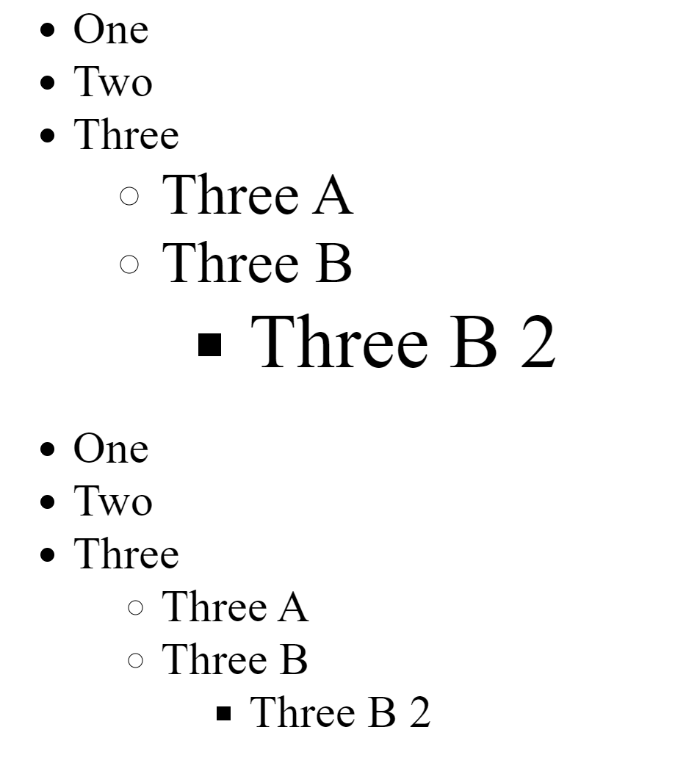
Lengths
However, if you change the <html> font-size in the CSS you will see that everything else changes relative to it — both rem- and em-sized text.

Slide 24
Lengths
Percentages
Percentages are always set relative to some other value.
For example, if you set an element's font-size as a percentage it will be a percentage of the font-size of the element's parent.
If you use a percentage for a width value, it will be a percentage of the width of the parent.

Slide 25
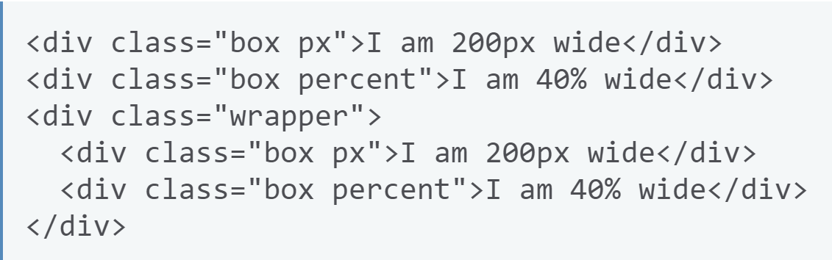
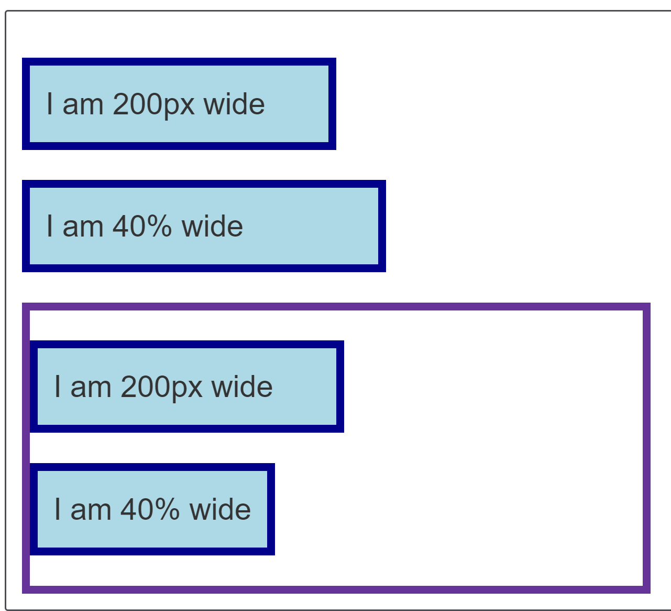
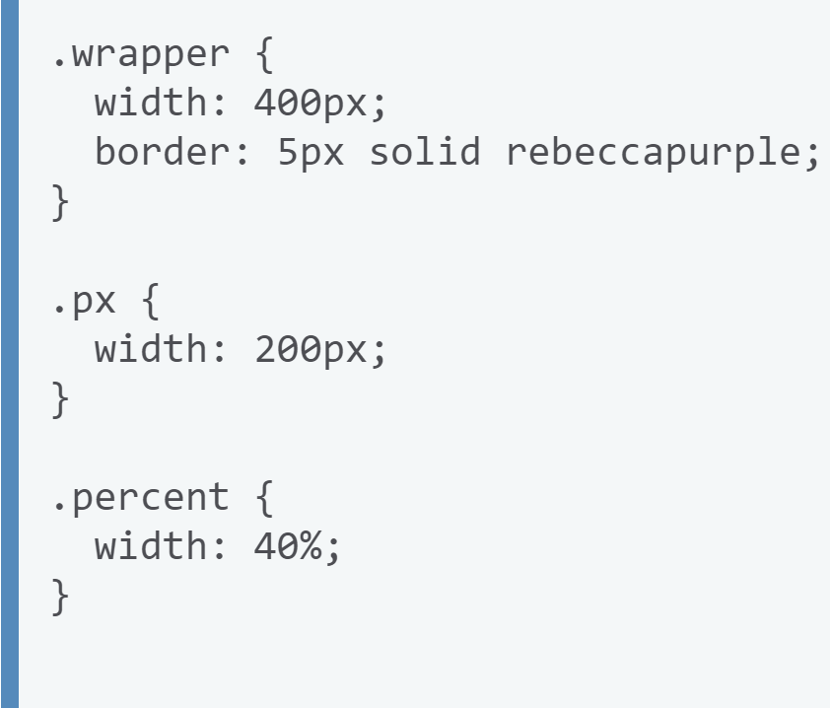
Lengths
Percentages

Slide 26
Lengths
Percentages
Example the two percentage-sized boxes and the two pixel-sized boxes have the same class names.
Both sets are 200px and 40% wide respectively.
The difference is that the second set of two boxes is inside a wrapper that is 400 pixels wide.
The second 200px wide box is the same width as the first one, but the second 40% box is now 40% of 400px — a lot narrower than the first one!

Slide 27
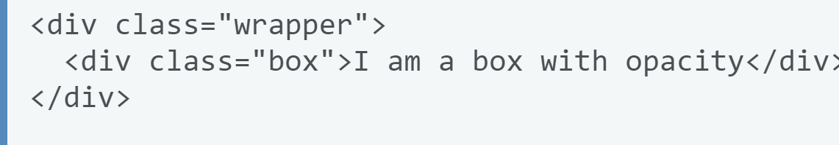

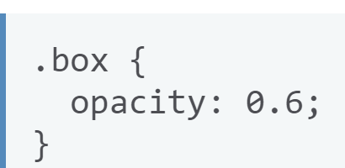
Lengths
Numbers
Some values accept numbers, without any unit added to them.
An example of a property which accepts a unitless number is the opacity property, which controls the opacity of an element (how transparent it is).
This property accepts a number between 0 (fully transparent) and 1 (fully opaque).

Slide 28
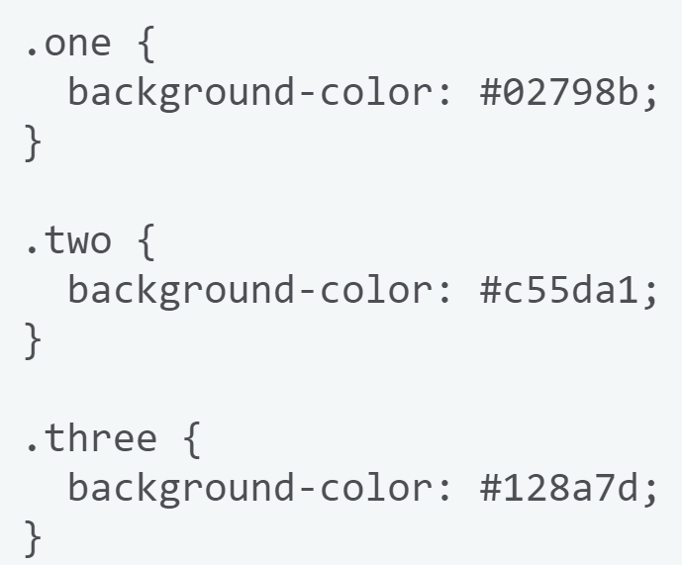
Color
Hexadecimal RGB values
Color value you are likely to encounter is hexadecimal codes.
Each hex value consists of a hash/pound symbol (#) followed by six hexadecimal numbers, each of which can take one of 16 values between 0 and f (which represents 15) — so 0123456789abcdef.
Each pair of values represents one of the channels — red, green and blue — and allows us to specify any of the 256 available values for each (16 x 16 = 256.)

Slide 29
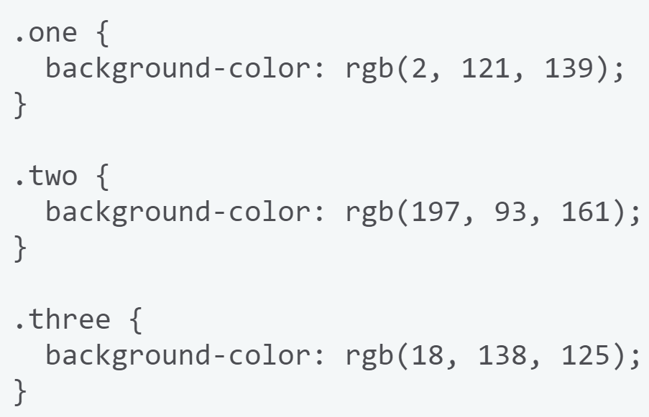
Color
RGB values
An RGB value is a function — rgb() — which is given three parameters that represent the red, green, and blue channel values of the colors, in much the same way as hex values.
The difference with RGB is that each channel is represented not by two hex digits, but by a decimal number between 0 and 255

Slide 30
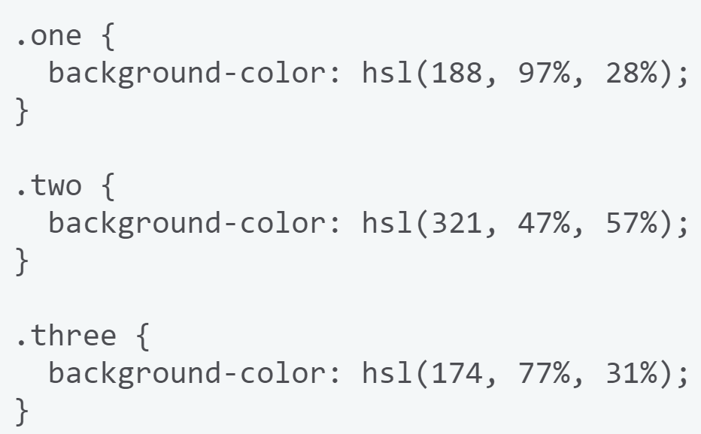
Color
HSL values
Slightly less well-supported than RGB is the HSL color model (not supported on old versions of IE), which was implemented after much interest from designers.
Instead of red, green, and blue values, the hsl() function accepts hue, saturation, and lightness values, which are used to distinguish between the 16.7 million colors, but in a different way:

Slide 31
Color
HSL values
Hue: The base shade of the color. This takes a value between 0 and 360, representing the angles round a color wheel.
Saturation: How saturated is the color? This takes a value from 0–100%, where 0 is no color (it will appear as a shade of grey), and 100% is full color saturation
Lightness: How light or bright is the color? This takes a value from 0–100%, where 0 is no light (it will appear completely black) and 100% is full light (it will appear completely white)

Slide 32
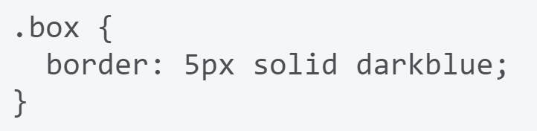
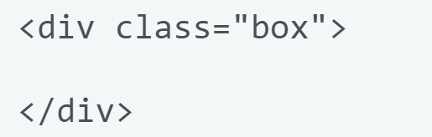
Setting a specific size
Intrinsic size of things
An empty <div> however, has no size of its own.
If you add a <div> to your HTML with no content, then give it a border as we did with the image, you will see a line on the page.
This is the collapsed border on the element — there is no content to hold it open.
We can of course give elements in our design a specific size.

Slide 33
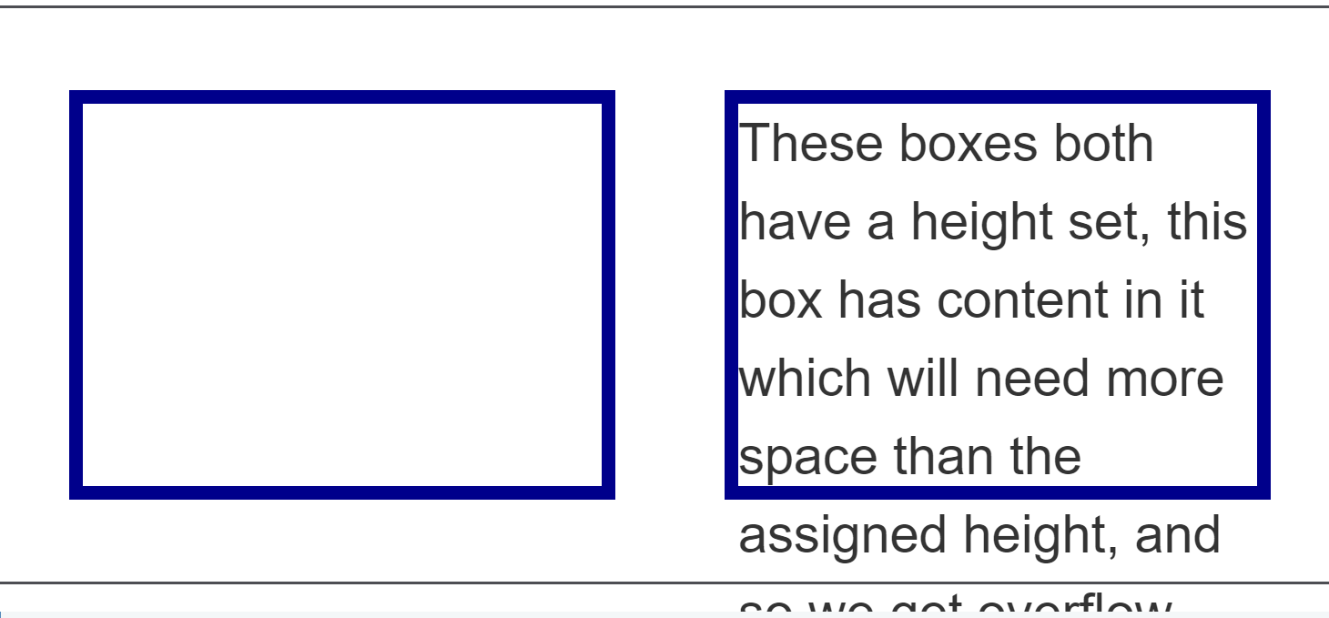
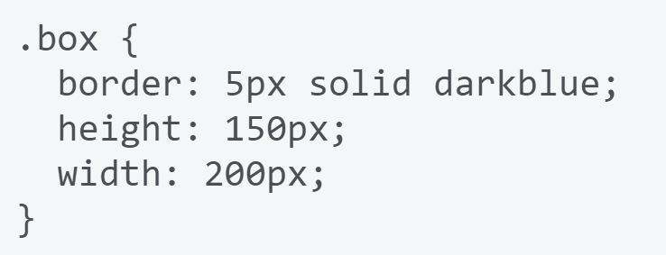
Setting a specific size
A set height can cause a content to overflow
Due to this problem of overflow, fixing the height of elements with lengths or percentages is something we need to do very carefully on the web

Slide 34
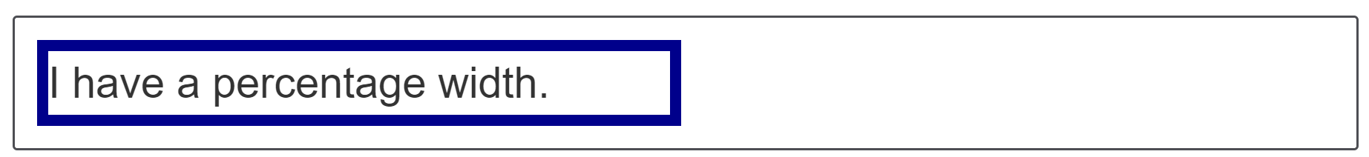
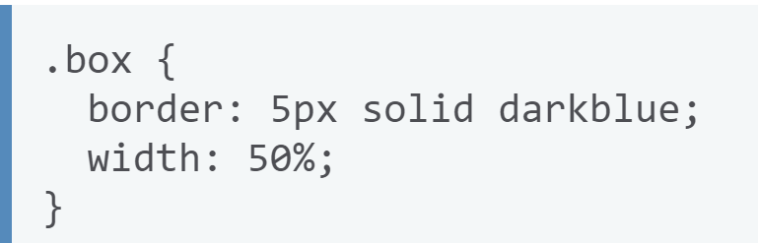
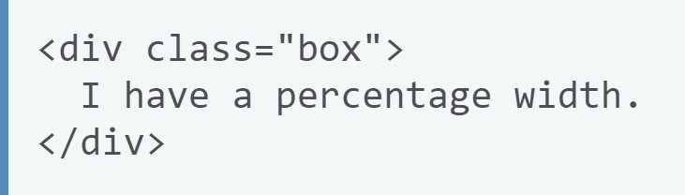
Setting a specific size
When using a percentage you need to be aware what it is a percentage of.
In the case of a box inside another container, if you give the child box a percentage width it will be a percentage of the width of the parent container.

Slide 35
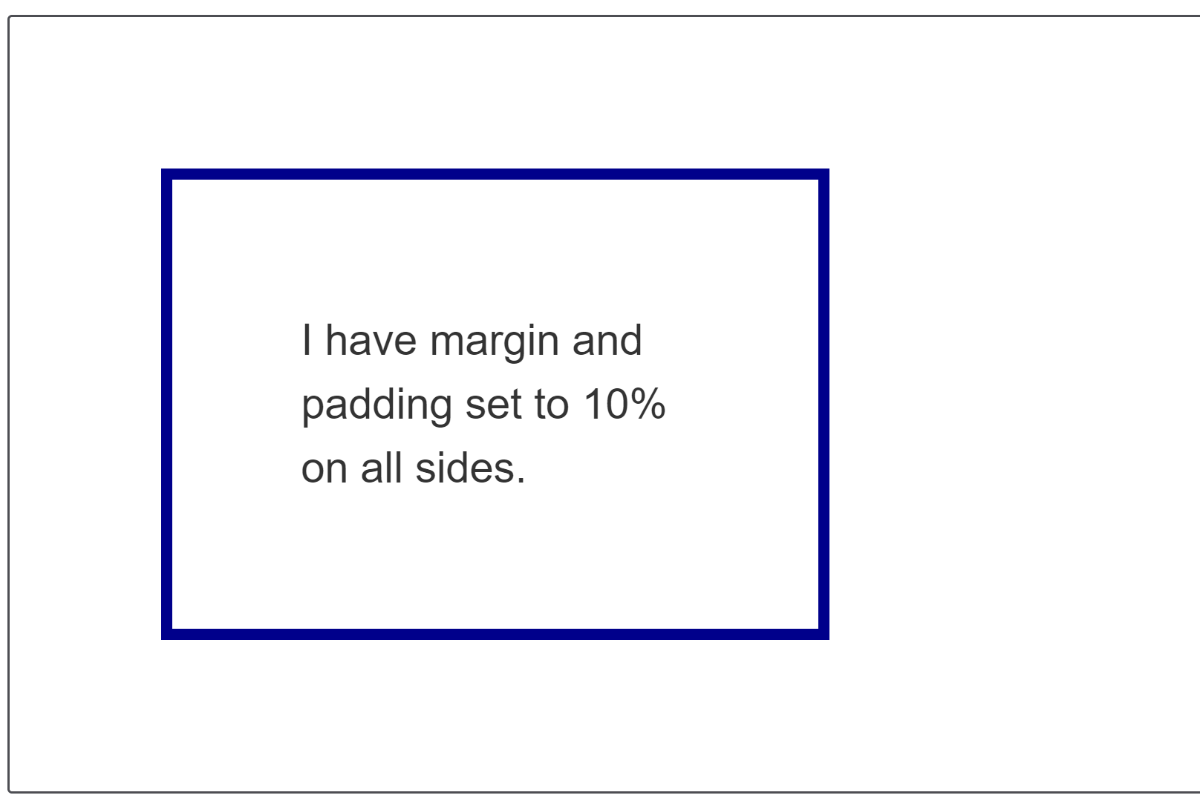
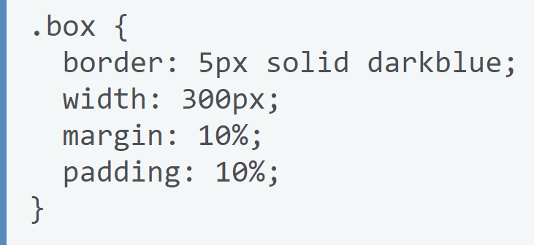
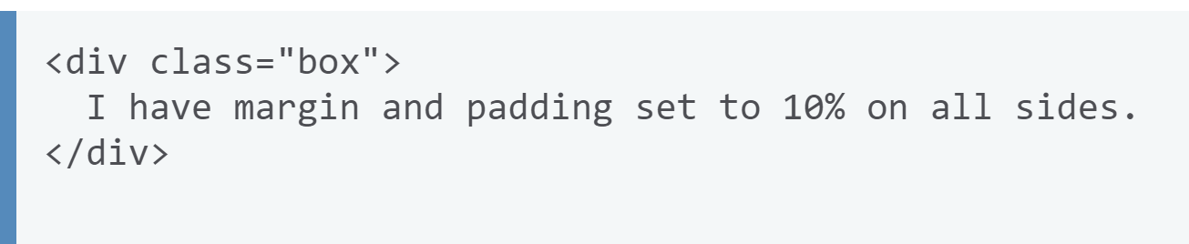
Setting a specific size
If you set margins and padding as a percentage you may notice some strange behavior. In the below example we have a box.
We have given the inner box a margin of 10% and a padding of 10%.
The padding and margin on the top and bottom of the box are the same size as the margin on the left and right.

Slide 36
Setting a specific size
You might expect for example the percentage top and bottom margins to be a percentage of the element's height, and the percentage left and right margins to be a percentage of the element's width.
However, this is not the case!
When you use margin and padding set in percentages, the value is calculated from the inline size — therefore the width when working in a horizontal language.
In our example, all of the margins and padding are 10% of the width.
This means you can have equal sized margins and padding all round the box.

Slide 37


Min and max size
In addition to giving things a fixed size, we can ask CSS to give an element a minimum or a maximum size.
If you have a box that might contain a variable amount of content, and you always want it to be at least a certain height, you could set the min-height property on it.
The box will always be at least this height, but will then grow taller if there is more content than the box has space for at its minimum height.

Slide 38

Min and max size

Slide 39
Questions

